Slide 1

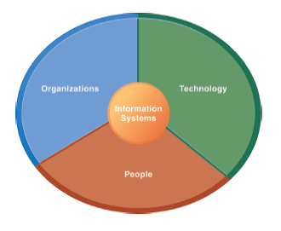
The Institute of Finance Management
ITU08117:
Information Systems Management
BAIT III
Mugyabuso, M. L
2023-2024
Notes:
There are two video cases and two instructional videos available for this chapter.

Slide 2
Business Process Analysis

Slide 3
Important Issues to Discuss
What is a business process analysis
Why business process analysis
When to undertake business process analysis
Performing business process analysis
The role of information systems in business process analysis

Slide 4
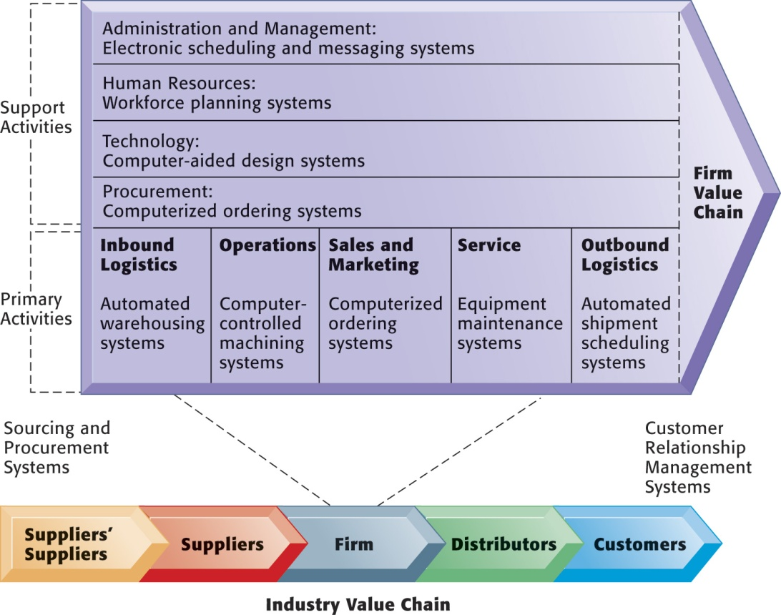
Viewing Business Processes from Value Chain Model
The Value Chain Model
Figure 3-2
Notes:
You can ask a single student to describe the business value chain in a business where they now work, or did work. Then ask the student to talk about how information systems were used in each step of the value chain.

Slide 5
What is a business process analysis?
Business process analysis is an activity in business process management (BPM)
A business process analysis is a method used to understand a process and improve its efficiency.
It looks at the steps and parties involved in a specific process and the information involved.

Slide 6
What is a business process analysis?
Business process analysis, is a method designed to help organizations review their processes.
Processes are repeatable groups of tasks or steps in a workflow that produce a certain result.
For example, the decision-making processes used in planning sessions.

Slide 7
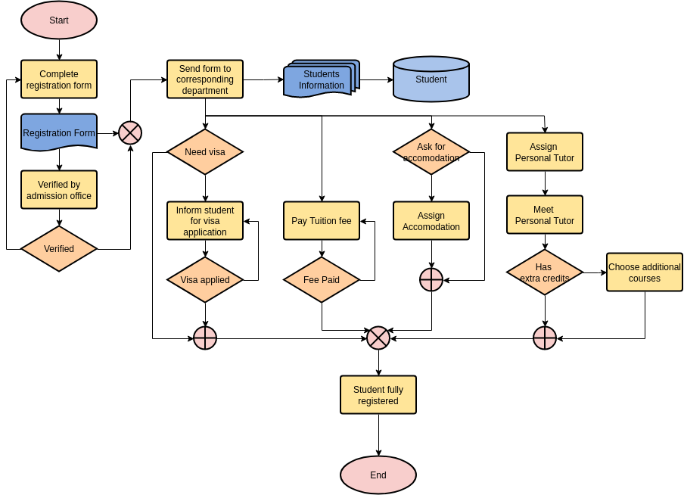

Slide 8
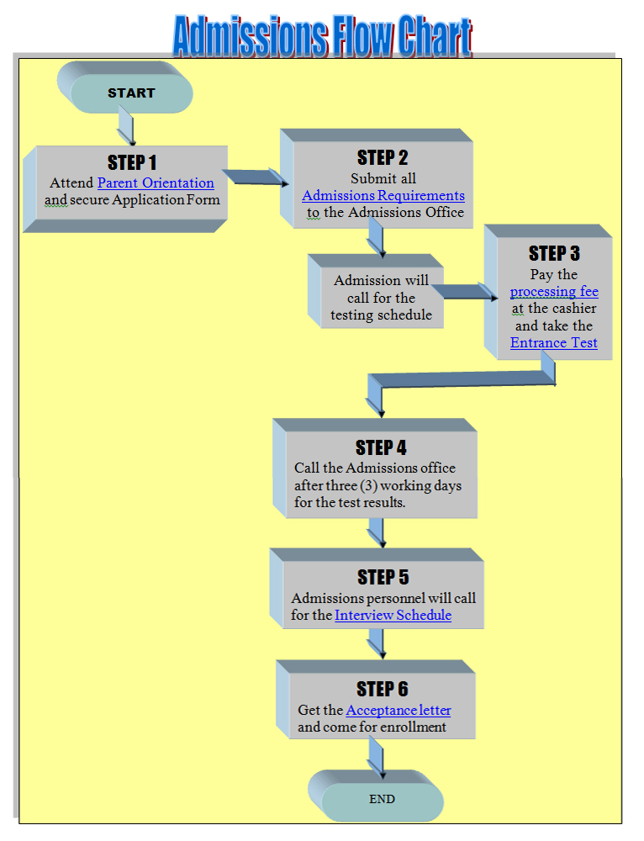

Slide 9
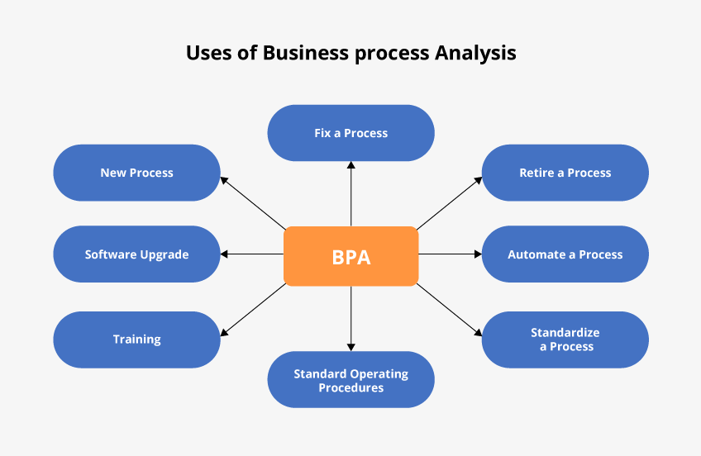
Why business process analysis

Slide 10
Why business process analysis
Identify gaps
Outline all available resources
Create new processes that align with the current culture and climate
Reduce redundancies, inefficiencies, and bottlenecks
Improve employee adoption
Create a better process flow

Slide 11
When to undertake business process analysis
Every organization should routinely evaluate its processes to identify opportunities for improvement.
Technological changes and innovations by competitors can result in processes that are obsolete and place an organization at a significant competitive disadvantage.

Slide 12
When to undertake business process analysis
Organizations should perform a business process analysis prior to introducing any new technology like automation into their processes.
Evidence of bottlenecks in existing processes are also a sign that a business process analysis is necessary.
These include issues like frequent delays, customer complaints, stakeholder confusion and/or reduced productivity.

Slide 13
Performing business process analysis
Business process analysis consists of 6-steps:
Identify and define your goals
Identify the process to be analyzed
Collect information
Map out the process
Analyze the process
Identify the potential for business process improvement

Slide 14
Performing business process analysis
Identify and define goals
identify what you hope to achieve by conducting an analysis. Effective goals generally follow the SMART acronym.
Identify and define the process
A good place to start is with smaller business-critical processes, or aspects of your organization that are underperforming.

Slide 15
Performing business process analysis
Collect information
Involve process stakeholders, they will have the most information and be able to identify issues and bottlenecks.
Map it out
Business process mapping is a planning and management tool that visually depicts all aspects of a process. sketching out a flowchart on a piece of paper.

Slide 16
Performing business process analysis
Analyze the process
Analyze the process AS-IS currently exists to identify inefficiencies and potential areas of improvement. Focus on: Key components.
like customer interactions, activities that add high value, and places where information is exchanged.
Bottlenecks and/or other reasons for delays
Inefficient or wasteful components

Slide 17
Performing business process analysis
Identify the potential for business process improvement
Return to the goals that you defined at the outset. Any improvements to your processes should further those goals.
Discuss your findings and recommendations with stakeholders.
Get their feedback.
Brainstorm and explore all possible solutions.
Design the TO-BE process.

Slide 18
How do you perform BPA
here are some common methods:
Root cause analysis: Use this analysis to identify the foundation of your processes and ensure it connects back to your company’s larger goals.
SWOT analysis: SWOT is an acronym that stands for strengths, weaknesses, opportunities, and threats. This can be a helpful analysis because it gives you insight into how your processes are succeeding and where they can improve.
Gap analysis: Gap analyses show you what’s missing in your processes when compared to your larger company goals.

Slide 19
Tools to Use for BPA
Analysts use software to design and map procedures to analyze business process gaps.
The following are some common business process analysis tools (software tools)
1. Heflo; 2. Kissflow; 3. Appian; 4. Signavio; 5. HOPEX Platform
All these they perform like PROJECT MANAGEMENT SOFTWARE that ensures keeping track of all activities and actors of the activities

Slide 20
The Role of information systems in business process analysis
The goal of an information system is to transform data into information in order to generate knowledge that can be used for decision-making.
In order for information to add value to a business and the decision maker it must possess characteristics to ensure quality.

Slide 21
The roles of IS
Categorized into three
Defining what the system can do for business
IS capabilities, and
Importance of IS in business processes

Slide 22
The roles of IS Defining what the system can do for business
Store and analyze information: Sophisticated and comprehensive databases, sometimes cloud-based, are used to store and analyze information pertaining to business functions. future issues.
Assist with making decisions: Information systems can compare in-house analyses to external sources.
Assist with business processes: Information systems are used to develop value-added systems for business functions.

Slide 23
The roles of IS IS capabilities
Information access: easy access to all business data
Data collection: Pool all internal and external data together and house them in data warehouses.
Collaboration: allow departments and distributed teams to collaborate on decisions.
Interpretation: IS can help managers understand the potential implications of that decision.
Presentation: having tools designed to create easy-to-understand reports for review by higher-level managers.

Slide 24
The roles of IS Importance of IS in business processes
1. Store and Analyze Information
2. Simplify Business Processes
3. Facilitate Decision-Making
4. Access to Full Data Control

Slide 25
NEXT
Information System (IS) strategy and IS strategic tools
Notes:
This slide lists some of the more common ways IS has played a central role in the quality movement.

